Slide 1
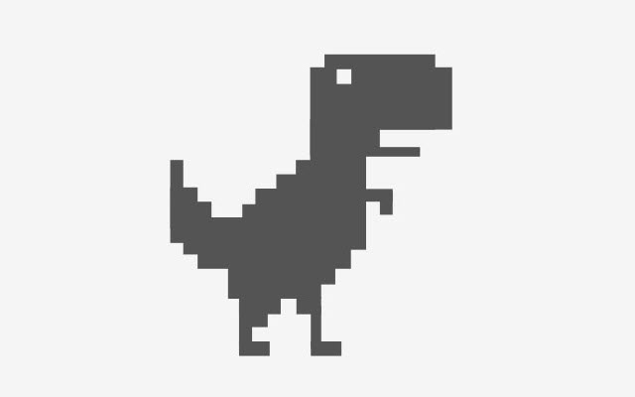
Capstone Project MVP (Minimum Viable Product)
Members: Alvin Henry 100709877
Nikhil Aleti 100851159
Dhvani Mevawala 100827131
Drasti Sutrariya 100850377
Rushikumar Patel 100852498

Slide 2
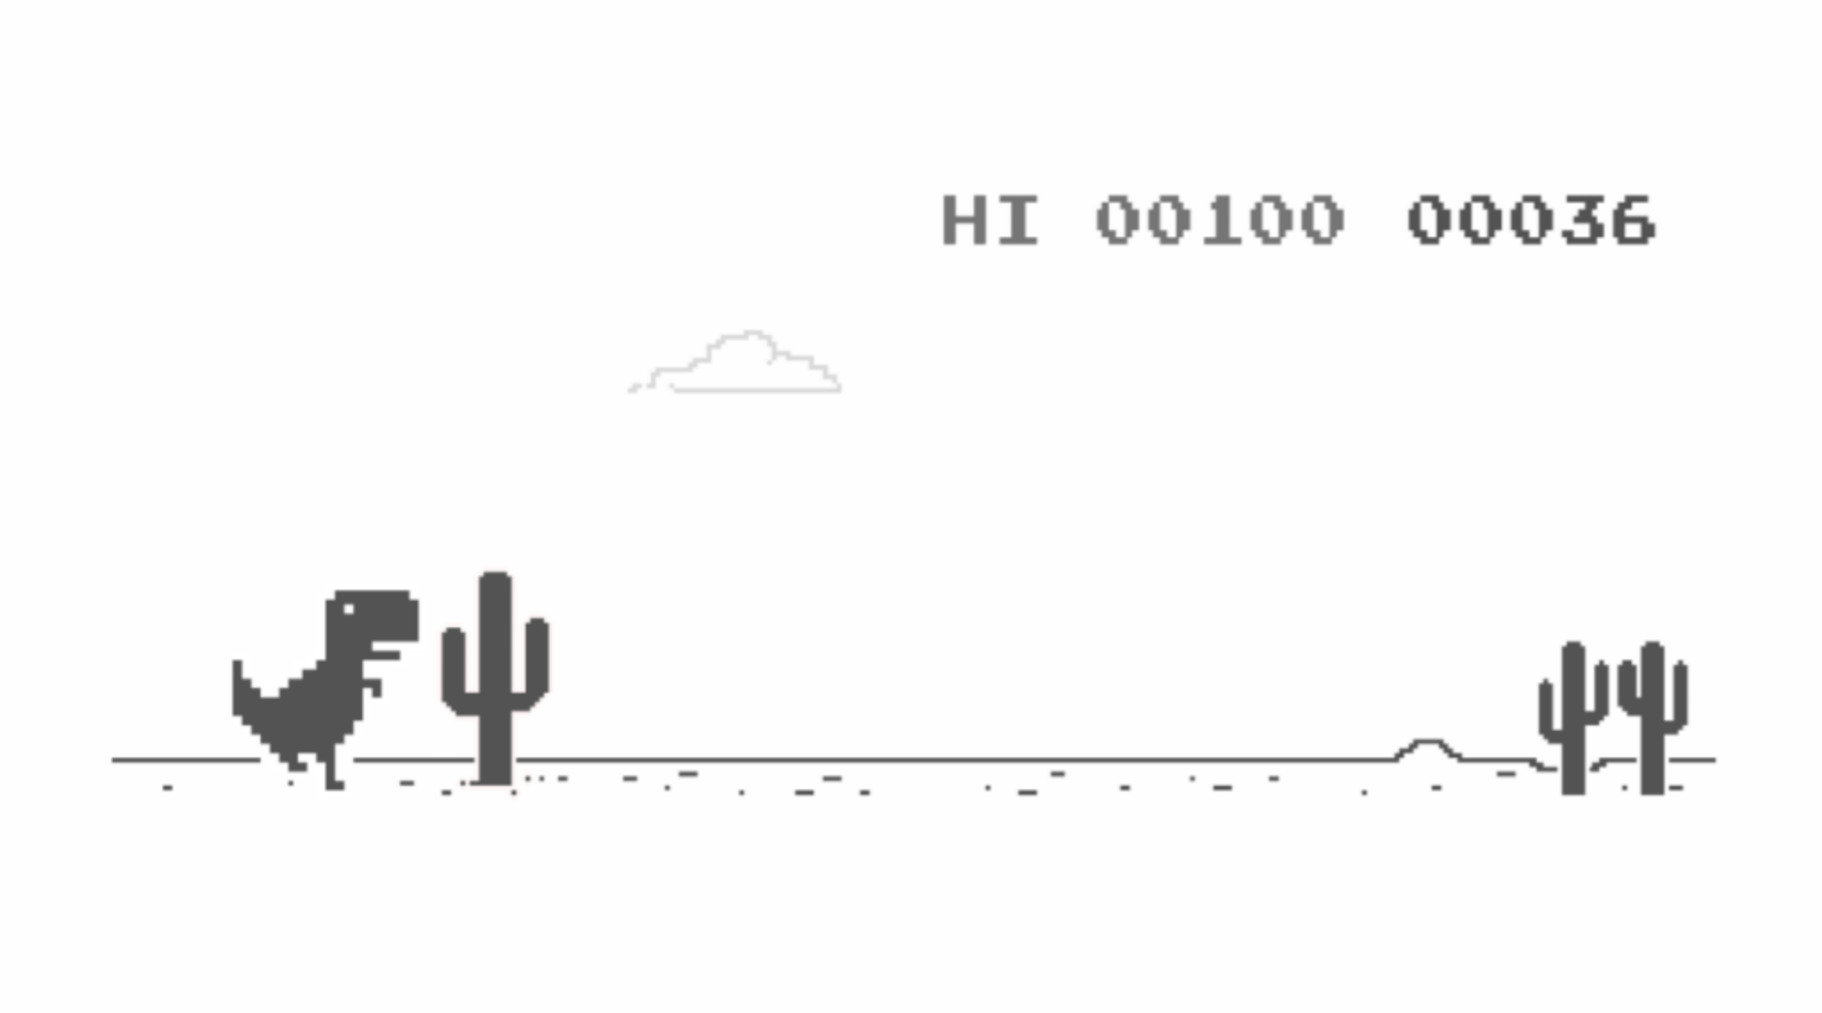
Dinosaur Game
The Dinosaur Game (Chrome Dino) is a browser game developed by Google and built into the chrome browser. The player controls a pixelated Tyrannosaurus rex across a side scrolling landscape, avoiding obstacles to achieve a high score

Slide 3

What Has Been Completed So Far
The code is functioning and working
NEAT algorithm has been used
Images were used for the Dinosaur and objects
Points, lives, speed

Slide 4
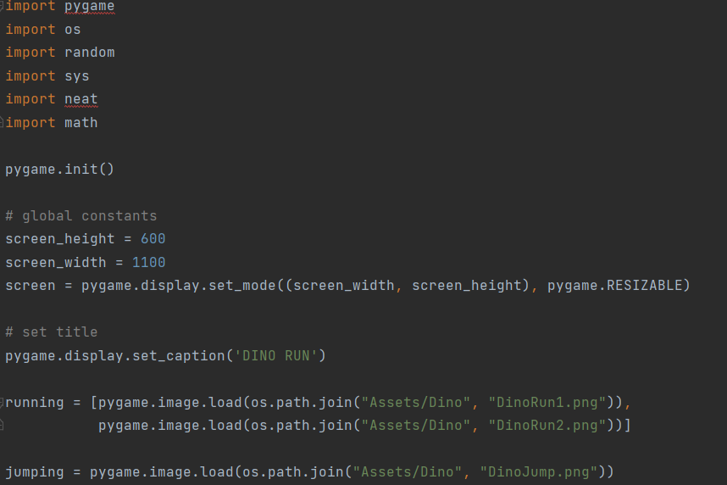
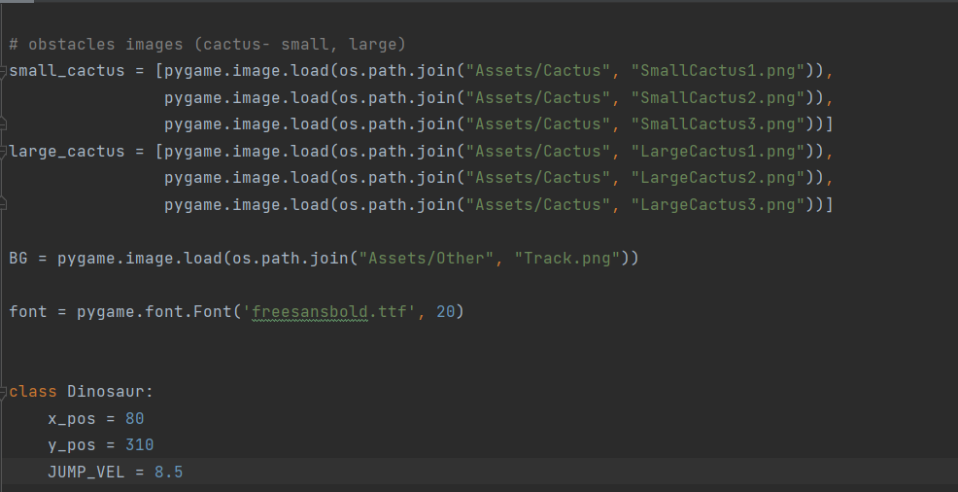
Code Run Down

Slide 5
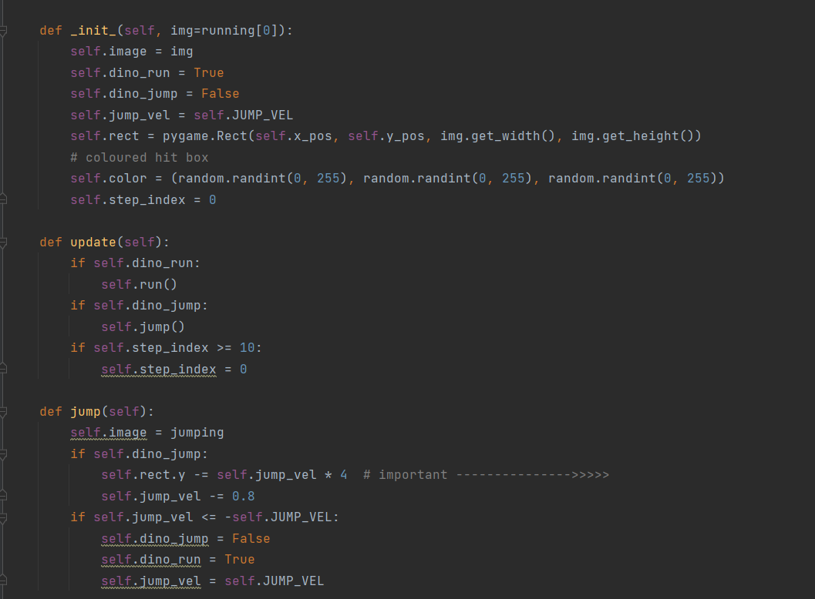
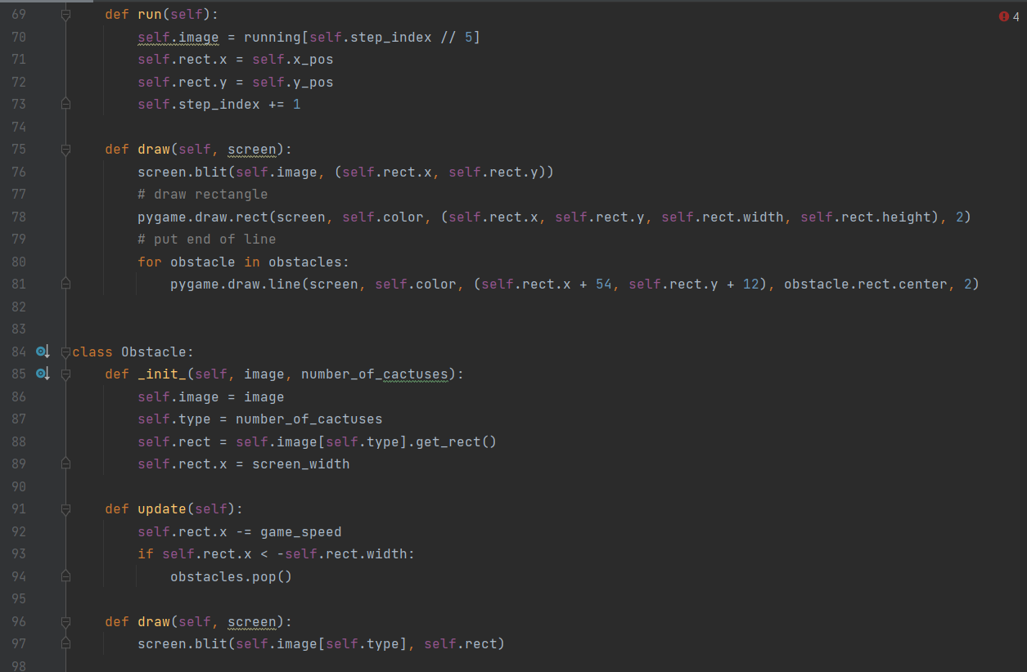
Code Run Down

Slide 6
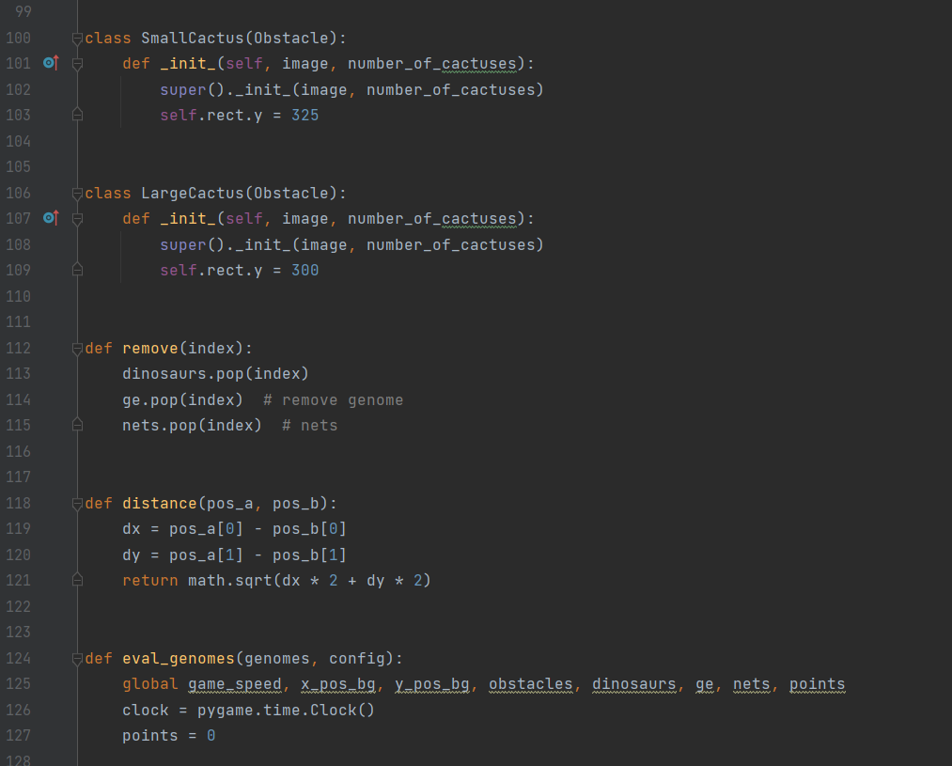
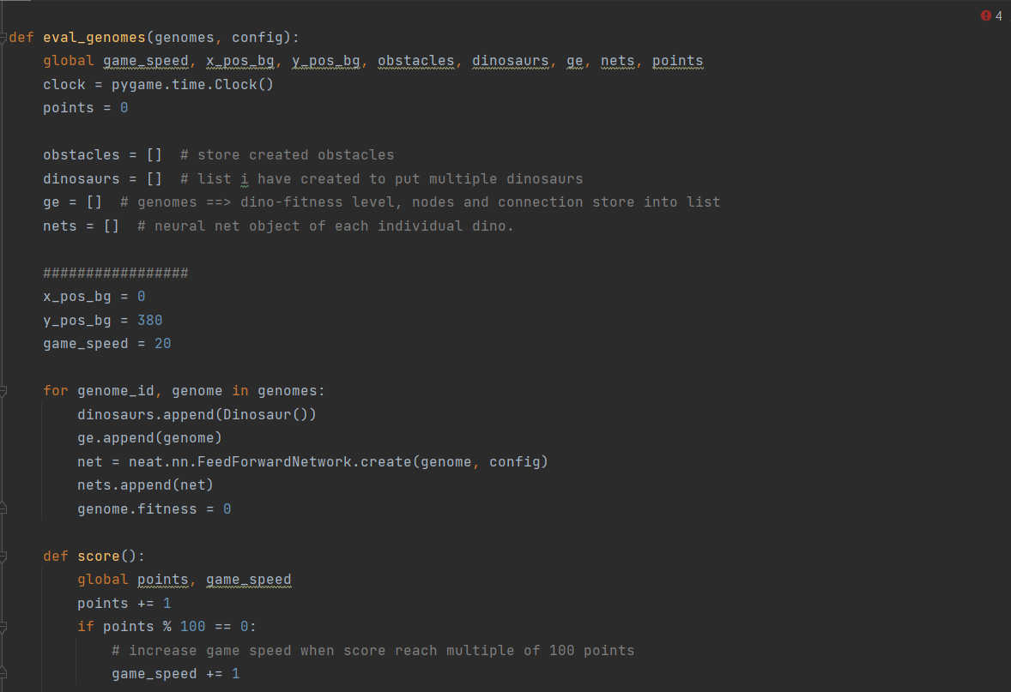
Code Run Down

Slide 7
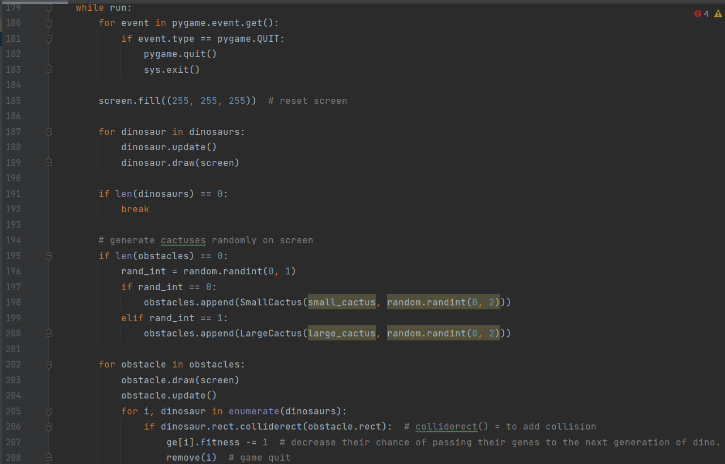
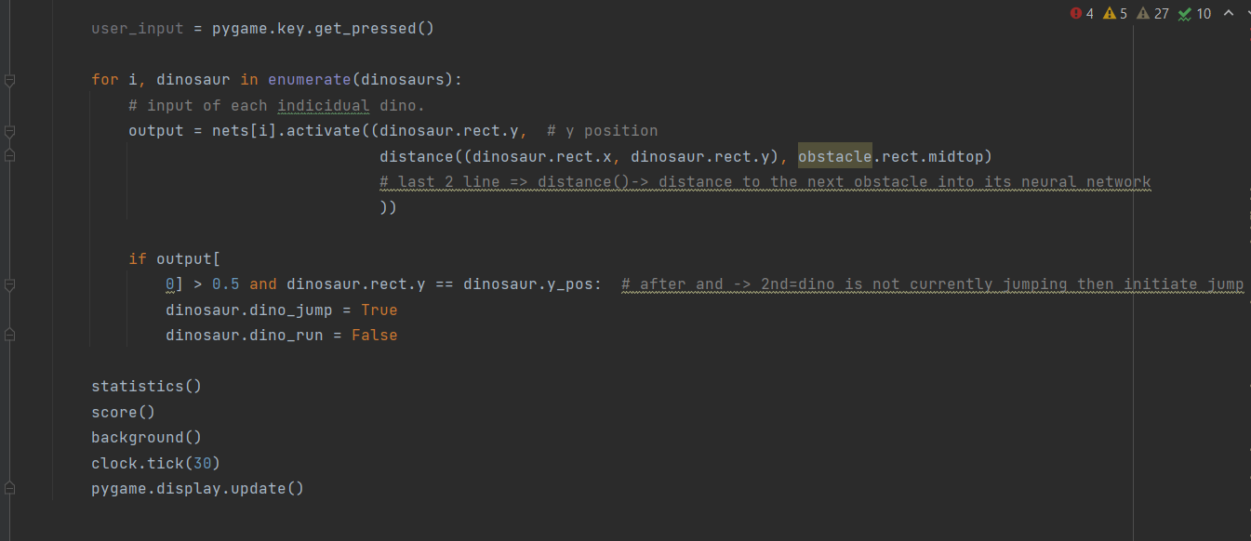
Code Run Down

Slide 8
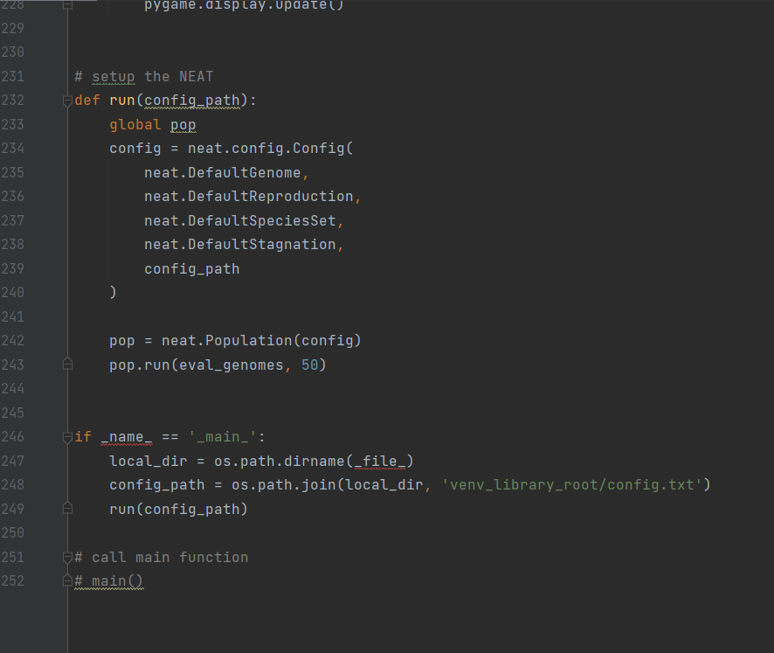
Code Run Down

Slide 9
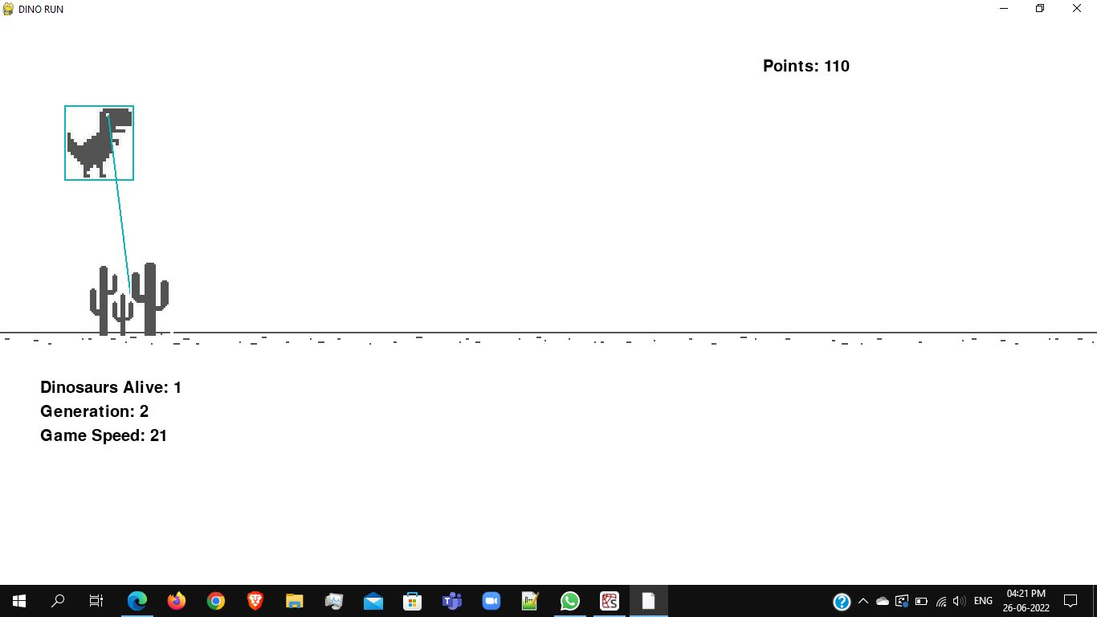

Slide 10
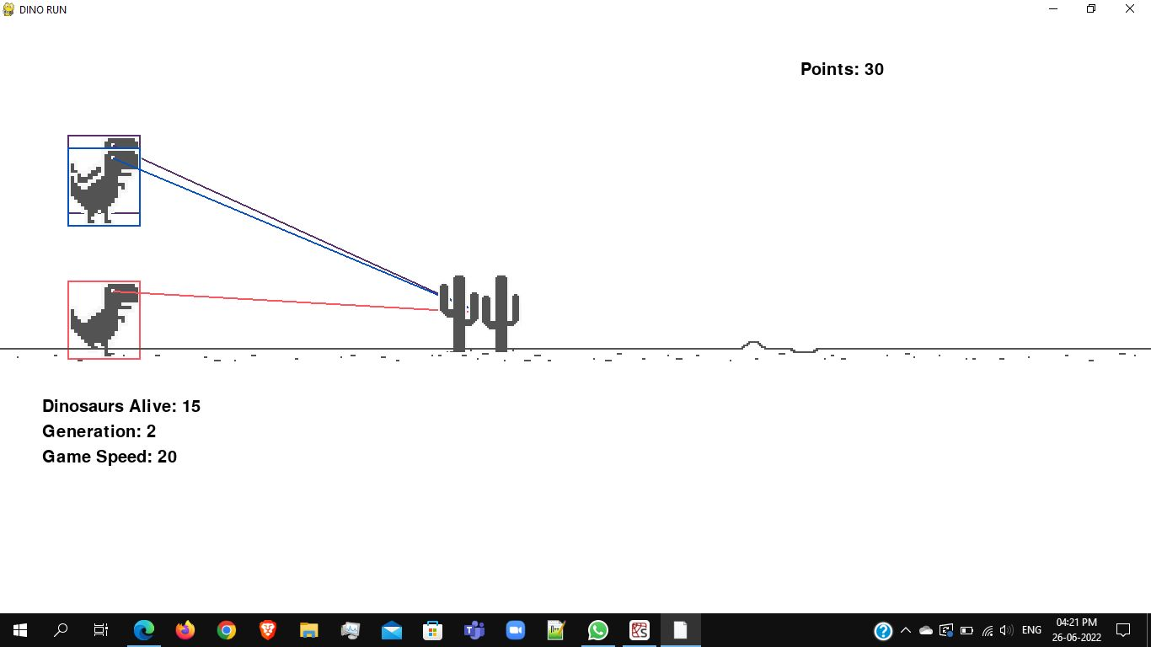

Slide 11


What Was Used
NEAT Algorithm (NeuroEvolution of Augmented Topologies)
Python Coding
PyCharm Program
Images

Slide 12
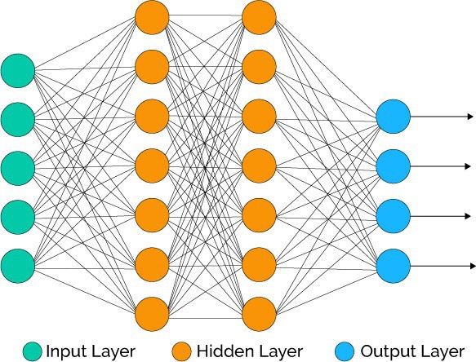
N.E.A.T Explained
NeuroEvolution of Augmented Topologies is a genetic algorithm for generation of evolving artificial neural networks, this was developed by Ken Stanley.
Will be important for the Dinosaur game, only input and output neurons are instantiated. Afterwards several networks will start playing the game and learning with crossover typical of genetic algorithms and classic selection.
Score performed during each generation will give a value expressive of the network’s goodness.

Slide 13
Conclusion
This is what we have done so far and will continue to look for any bugs and add on to the code to make it more unique than the original build and add the bird

Slide 14
References
https://github.com/BiagioFesta/aimaze2
http://nn.cs.utexas.edu/downloads/papers/stanley.ec02.pdf
https://en.wikipedia.org/wiki/Neuroevolution_of_augmenting_topologies#:~:text=NeuroEvolution%20of%20Augmenting%20Topologies%20(NEAT,University%20of%20Texas%20at%20Austin.

